Slide 1
Exception Handling in Python
Introduction to Errors, Exceptions, and Handling Techniques

Slide 2
What is Exception Handling?
Definition
Why is it important?
Exception Handling refers to the process of responding to the occurrence of exceptions – anomalous or exceptional conditions requiring special processing.
Ensures the smooth running of code.
Prevents crashes and handles unexpected inputs or behavior gracefully.

Slide 3
Types of Errors
Syntax Errors
Exceptions
Occur when the parser detects a syntactical mistake.
Example: print("Hello)
Errors detected during execution.
Example: Division by zero (ZeroDivisionError).

Slide 4
Common Python Exceptions
ZeroDivisionError: Raised when you attempt to divide a number by zero.
ValueError: Raised when a function receives an argument of the correct type but inappropriate value.
TypeError: Raised when an operation or function is applied to an object of inappropriate type.
IndexError: Raised when attempting to access an index that is out of the valid range for a list or other sequence.
KeyError: Raised when a dictionary key is not found.

Slide 5
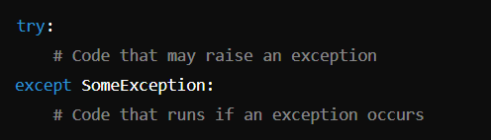
Basic Structure of Try-Except Block
Try Block: Code to be executed.
Except Block: Handles specific exceptions that occur in the try block.

Slide 6
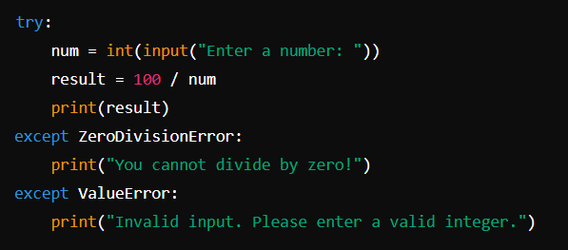
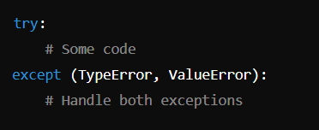
Example of Try-Except
Catching Multiple Exceptions

Slide 7
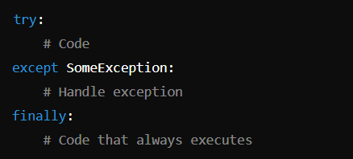
Finally Block
Always executes whether an exception occurred or not.

Slide 8
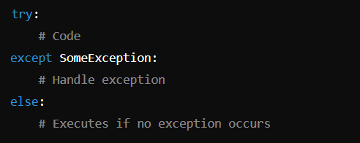
ELSE Block
The else block executes if no exception occurs.

Slide 9
THANK YOU!
HAPPY LEARNING

